Slide 1
Hospitality Report analytics & Dashboard
Group 2
Mr. Lokesh. R | lokeshramesh08@gmail.com | 7094011474
Miss. Priyanka Vishnudas Chavan | priyankachavan19@gmail.com | 9922031248
Ms. Sriega R | sriegaraju38@gmail.com | 7824931987
Ms. Nithya N | nithyanandakumar466@gmail.com | 9629749329
Miss Pranali Gedam | gedamp68@gmail.com | 8668574087
Miss Aishwarya u.k | aishwarya98hr@gmail.com | 7406021164
Miss Fiza Asif Machchhar | fizzzzz93@gmail.com | 8828048542

Slide 2
Summary
AtliQ Hotels is a chain of five-star hotels across India. Associated in the hospitality industry for the past 20 years however, due to the rising share of competitors and feeble decision-making of the management system, AtliQ Hotels are losing its market share and revenue in the luxury/business hotels category.
Revenue generation and increasing profitability are the sole strategic operations that touches every part of an organization, and the hospitality industry is no exception. In hospitality domain, factors that majorly affect revenue generation are hotel room rentals, meeting space occupancy, ambience and amiability.
A comprehensive and detailed analysis was performed of hotel data for AtliQ Grands, from May 2022-June 2022, in order to provide insights for their statistical data to regain their market share and revenue.
Various field metrics such as RevPAR, ADR , Occupancy% , Customer Ratings, Bookings and a lot more was analysed which managed to deep-dive into the core issues in the management system.
The data cleaning was done using MySQL, modelled by Excel and Power BI and later visualised using Tableau.
AtliQ chain have their properties distributed in the cities of Mumbai, Delhi, Bangalore and Hyderabad. Also they have different categories in it that lists, AtliQ Bay, AtliQ Blu, AtliQ city, AtliQ Exotica, AtliQ Grands, AtliQ Palace & AtliQ Seasons.

Slide 3
LIST OF KPI’S
Revenue : It’s the total revenue realised. Within a span of three months, the business was able to generate a revenue of 1.71 billion.
Occupancy% : Occupancy means total successful bookings happened to the total rooms available(capacity). The occupancy rate across all locations is slightly above 50%, overall it’s 57.87%. This means that on an average, atleast 50% of the rooms are occupied daily.
ADR : It is the ratio of revenue to the total rooms booked/sold. It is the measure of the average paid for rooms sold in a given time period. The average selling price for a room is 12.70K.
RevPAR : RevPAR represents the revenue generated per available room, whether or not they are occupied. RevPAR helps hotels measure their revenue generating performance to accurately price rooms. RevPAR can help hotels measure themselves against other properties or brands. For this dataset the RevPAR is 7350.
DSRN : This metrics tells on average how many rooms are ready to sell for a day considering a time period. The DSRN is 2528 for AtliQ.
Realisation% : It is nothing but the succesful "checked out" percentage over all bookings happened. The realisation% is 70.15

Slide 4
EXCEL DASHBOARD

Slide 5
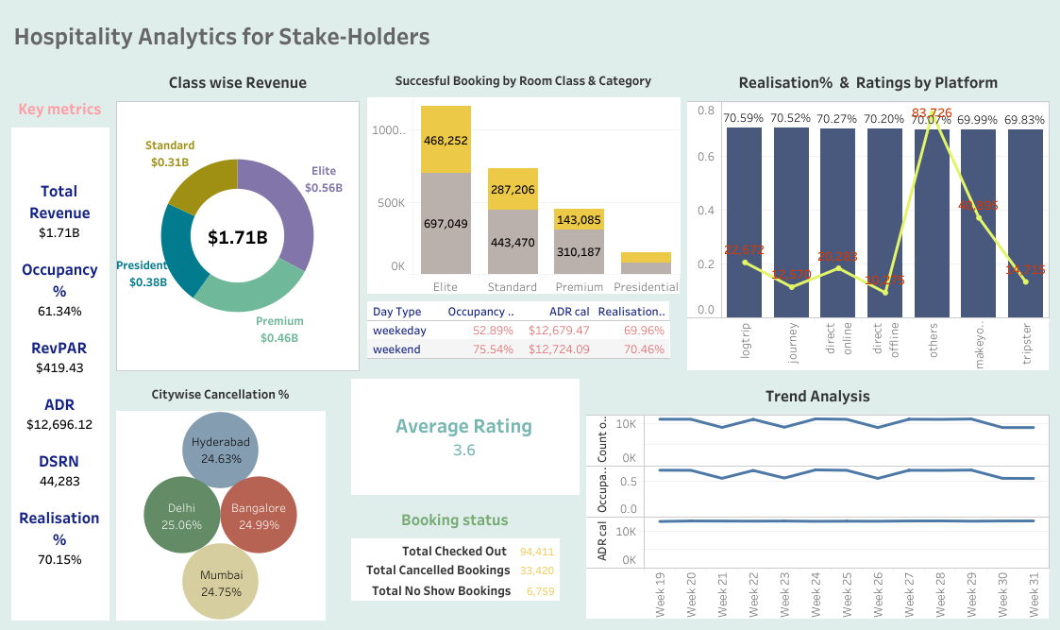
TABLEAU DASHBOARD

Slide 6
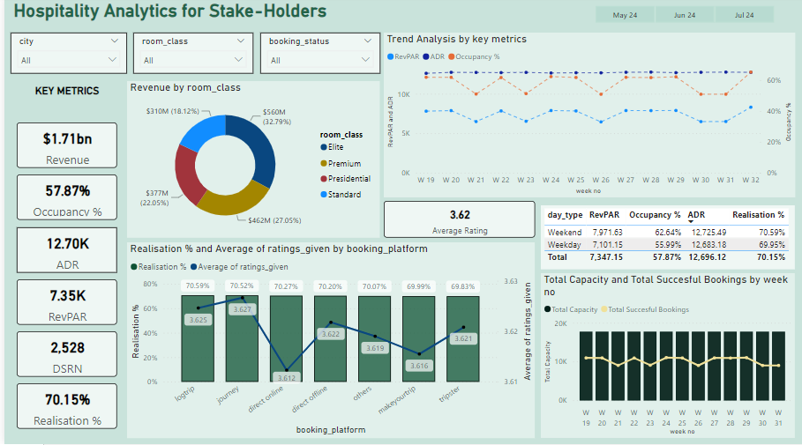
POWER BI DASHBOARD

Slide 7
Key takeaways
City-wise Mumbai generates the highest revenue followed by Bangalore, Hyderabad & Delhi.
Elite room class generates the highest revenue (32.79%) followed by Premium (27.05) and Presidential (22.05).
The realisation% is almost the same on every platform, promotions can be increased on the hotels private website giving souvenir & discount coupons so as to attract major share of bookings and revenue onto the hotels internal platform.
In the trend analysis it’s clearly visible that Occupancy and RevPAR follows the same trend over the tenure of week 19 to week 32 however, ADR follows a straight line.
This reveals that the management of AtliQ Grands follows the STATIC PRICING for their hotel rooms, abstaining the revenue growth. Instead they can adapt WEEKEND-WEEKDAY PRICING or DYNAMIC PRICING boosting the revenue growth rate upto 30% .
Among all AtliQ Blu has the highest rating.
On Weekends the revenue generated is 640 M, where as on the Weekdays combined revenue generated is 1 B.

Slide 8
THANK YOU

